Slide 1

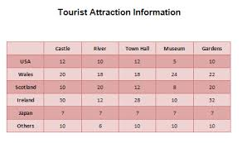
Tables in Word

Slide 2
Design of Tables
A table style provides a consistent look to borders, shading, alignment and fonts in tables.

Slide 3
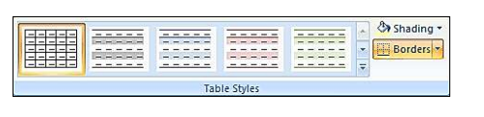
Design of a Table
Use an existing table or insert a new table :
Insert: (Revision) Click the Table item . Select Insert Table from the menu
Now click on the Design tab.
Locate the Table Styles panel

Slide 4
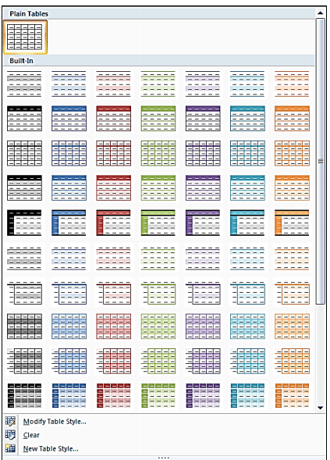
Click the bottom arrow on the styles area to see more appear:

Slide 5

Select one that suits the table contents
Try them all out to see what they look like.
There's a lot more you can do with them, so have a play around with the various options and see how you get on.
Create something very impressive!

Slide 6
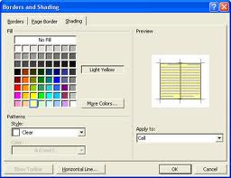
Adding Borders Select the cells you want to apply borders to HINTS: To select multiple contiguous cells, click in one cell and hold the mouse button while dragging across the desired cells. To select multiple non-contiguous cells, press and hold [Ctrl] while clicking each desired cell.
Borders and Shading

Slide 7
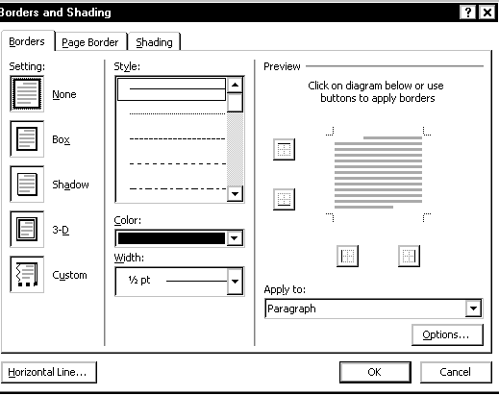
In the Table Styles group, click the Down arrow on BORDERS
Borders button select Borders and Shading.

Slide 8
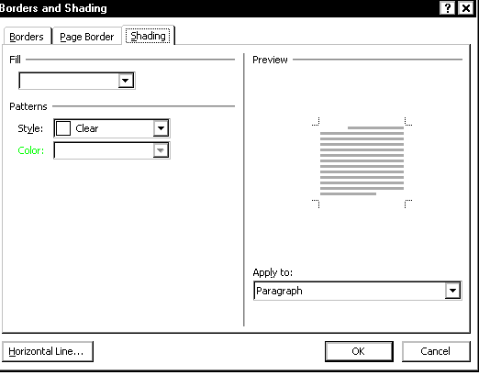
Select the Shading tab

Slide 9
Paragraph
Applies color to the text area in selected cell(s); color does not fill the entire cell
Cell
Fills selected cell(s) with color
Table
Applies color to entire table
Click OK
The changes are applied.

Slide 10
To select a shading color, under Fill, select the desired shading option
OPTIONAL: Under Patterns, from the Style pull-down list, select the desired shading pattern
From the Apply to pull-down list, select where you want the color applied

Slide 11
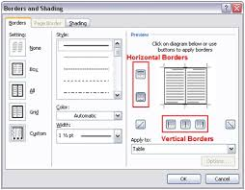
Experiment with the Table Toolbar, and see what else you can change about your table. Have fun!
Table Borders and Shading

Slide 12

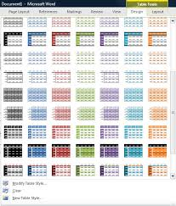

Activity
Learner’s worksheet in DataFiles_Solutions Folder

